Slide 1

ABSTRACT CLASS
AND INTERFACE

Slide 2

ABSTRACTION
Hiding internal details, showing only necessary information.
Ex: Smart phone.
⟶two ways to perform the abstraction.
1-abstract class 2-interface

Slide 3

ABSTRACT:
Abstract is a scenario or a idea which exists in thoughts but not physically.
Ex: A map

Slide 4

ABSTRACT
METHOD:
A method that is declared without an implementation.
Ex: Abstact void meth1 (double x,double y)

Slide 5

ABSTRACT CLASS:
if a class includes methods, than the class itself must be
declared abstract.
It can have abstract and non-abstract methods.
Non-abstract method (concrete method).
If a class contain partial implementation then we should declare a class as abstract.
Ex:- public abstract class phone {
abstract void switchoff () {
}
}

Slide 6

ABSTRACT CLASS:
We can’t create object in abstract class but we can make reference variable.
Abstract class is the super class and every super class has capability to store the other class object.

Slide 7
ABSTRACT CLASS:
It can have abstract and non-abstract methods.
To use an abstract class, you have to inherit it from sub-classes.

Slide 8
BENEFITS OF ABSTRACT CLASS
provide security
Code reusability
Reduce complexity

Slide 9
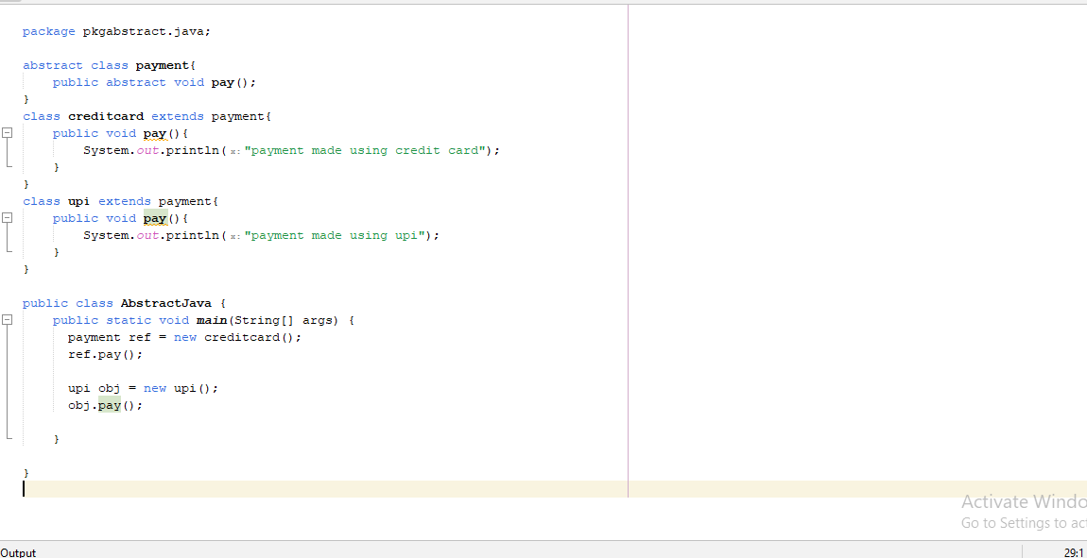

Slide 10
INTERFACE:
interface is a point where two systems meet and interact.
Ex:- ATM Machine.
in java interface is just like a class which contains only abstract methods.

Slide 11
INTERFACE:
To achieve interface java provides a keyword called implements.
Interface methods are by default public and abstract.

Slide 12
INTERFACE:
-interface variables are by default public ,static and final.
-interface methods must be override inside the implementing classes.

Slide 13
BENEFITS OF INTERFACe
Reusability
Flexibility
Maintainability

Slide 14
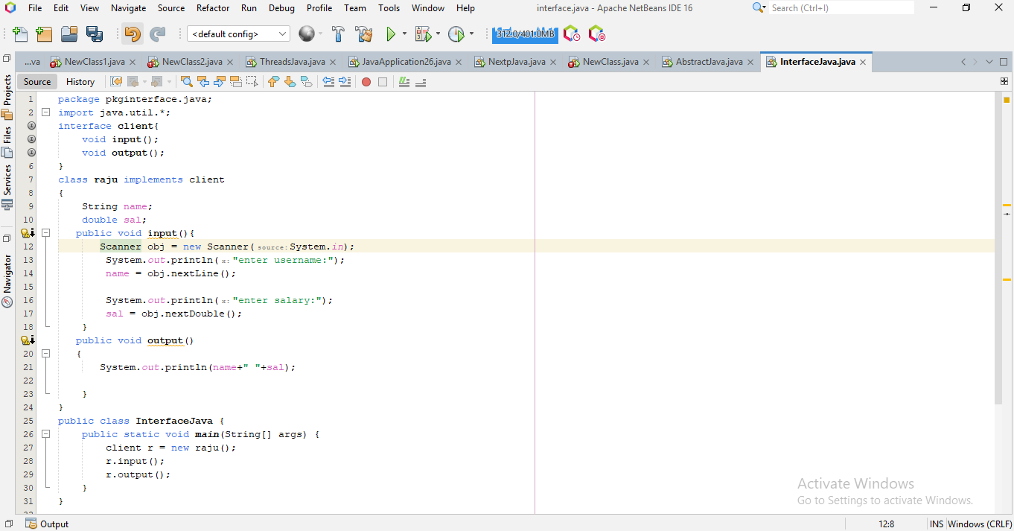

Slide 15
DIFFERENTIATE:
INTERFACE:
Interface can be implemented more than one.
no constructor
ABSTRACT:
abstract can be extended only once.
can have constructor.

Slide 16
DIFFERENTIATE:
INTERFACE:
All methods are public by default.
Support multiple inheritance.
ABSTRACT CLASS:
Can have any access modifier.
Don’t support multiple inheritance.

Slide 17
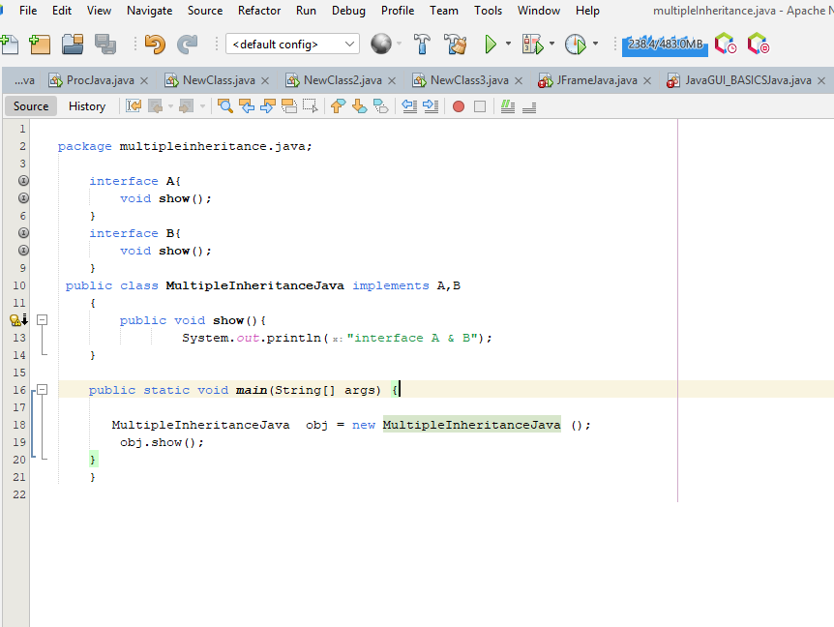

Slide 18
Thank you

